Slide 1
Predicting and Explaining FedEx Cup Standings:
Comparing Traditional Rate Statistics to Newer Strokes Gained Metrics
Jess Erben, Quinn Hungerford, Allison Nguyen

Slide 2
Research Question and Objective
Q: Are traditional rate metrics or Strokes Gained (SG) metrics better predictors of FedEx Cup points? And which variables within each group most strongly explain player performance across seasons?
Objectives:
Evaluate whether traditional rate statistics or Strokes Gained metrics better explain and predict PGA Tour player performance, quantified using FedEx Cup points.
Identify which variables are most strongly associated with points and forecast 2025 outcomes using 2024 data.
Context:
FedEx Cup Points serve as a ranking system that rewards consistent success and determines Playoff standings. Points are allocated based on field strength, tournament importance, and finishing position.
Provides insight into what skills matter most for competitive success on the PGA Tour.

Slide 3
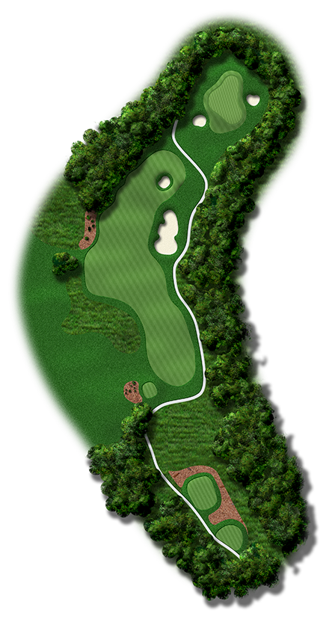
Rate Statistics (Golf 101)
Fairway in Regulation (FIR): Tee Shots that land in the fairway
FIR % : Tee Shots that land in Fairway/Total Tee Shots
Green in Regulation (GIR): Approach Shots that land on the green.
Par 3: First Shot
Par 4: Second shot.
Par 5: Third shot
  If your second shot on a Par 5 lands on the green, this is called a Green Under Regulation (GUR), but statistically is counted as a GIR.
GIR %: Approach Shots that land on the Green/Total Number of Approach Shots
Scrambling: If a player misses the GIR, how often do they still score par or better?
Scrambling %: Number of times par or better score on missed GIR/Total missed GIR
Overall Putting Average: Total Number of Putts / Total Number of Holes Played

Slide 4
Strokes Gained Statistics
Assume the function J(d, c), where:
d - represents the distance to the hole from the current location
c - represents the condition of the current ball location (like green, tee, fairway, rough, sand, recovery)
J - the average number of strokes a PGA TOUR golfer takes to finish the hole from the current distance and condition (the benchmark)
Strokes Gained of the i^{th} shot on a hole that starts at ( d_{i} , c_{i} ) and finishes at ( d_{i+1} , c_{i+1} ) is defined:
g_{i} = J ( d_{i} , c_{i} ) – J ( d_{i+1} , c_{i+1} ) – 1
In other words, “strokes gained represents the decrease in the average number of strokes to finish the hole from beginning of the shot to the end of the shot, minus one to account for the stroke taken.”
Measures the expected strokes the average PGA player would take to finish the hole at the beginning of a shot minus the expected strokes they would take to finish the hole from where the ball landed.
Based on distance to the hole and the condition the ball is in.
Similar to calculating Run Expectancy in baseball! (Previously done in class)
Notes:
“Strokes gained is a simple and intuitive quantitative measure of the quality of a golf shot.
Suppose a function J(d, c) has been estimated, where d represents the distance to the hole from the current location (not the distance of the shot), c represents the condition of the current ball location (i.e., green, tee, fairway, rough, sand or recovery) and J is the average number of strokes a PGA TOUR golfer takes to finish the hole from the current location. For brevity, J will often be referred to as the benchmark. Define the strokes gained of the ith shot on a hole that starts at (di, ci) and finishes at (di+1, ci+1) to be
gi=J(di, ci)−J(di+1, ci+1) − 1
Strokes gained represents the decrease in the average number of strokes to finish the hole from the beginning of the shot to the end of the shot, minus one to account for the stroke taken.”
Broadie, Mark. (2011). Assessing Golfer Performance on the PGA Tour. Interfaces. 42. 10.2307/41472743.

Slide 5
Key Variables & Data Source
Strokes Gained:
Average Strokes Gained Off the Tee
Average Strokes Gained Approach
Average Strokes Gained Around the Green
Average Strokes Gained Putting
Rate Stats:
Fairways in Regulation Percentage
Greens in Regulation Percentage
Scrambling Percentage
Overall Putting Average
Outcome Variable:
FedEx Cup Points
Other:
Player (Name)
Player ID
All data for this project was collected from the official PGA Tour statistics website, which provides downloadable tables for each performance metric. For every category, we selected the relevant year and filtered for the TOUR Championship (year-to-date) totals to capture each player’s full-season performance.

Slide 6
Methodology
Data Collection & Preparation
Downloaded 2024 and 2025 PGA Tour stats and merged tables using Player ID.
Created two datasets: 2024 season through Sept 1, 2024 (training) and 2025 season through Aug 24, 2025 (testing)
Exploratory Data Analysis
Computed summary statistics for all variables and examined correlation matrices.
Normalized Outcome Variable (FedEx Cup Points)
Found that Total Points was highly right-skewed (Gamma distribution).
Performed a Box–Cox power transformation, or included Gamma argument in lm().
Model Building (Training on 2024)
Rate Stats GLM: Box-Cox FedEx Points ~ FIR% + GIR% + Scrambling% + Putting Avg.
Strokes Gained GLM: Box-Cox FedEx Points ~ SG Off-the-Tee + SG Approach + SG Around-the-Green + SG Putting.
Evaluate Predictive Performance (Testing on 2025)
Inverted Box–Cox to obtain predictions on the original scale
Compared models using predictive correlation, RMSE, MAE, R², MAPE
Visualized Actual vs Predicted and ranking accuracy

Slide 7
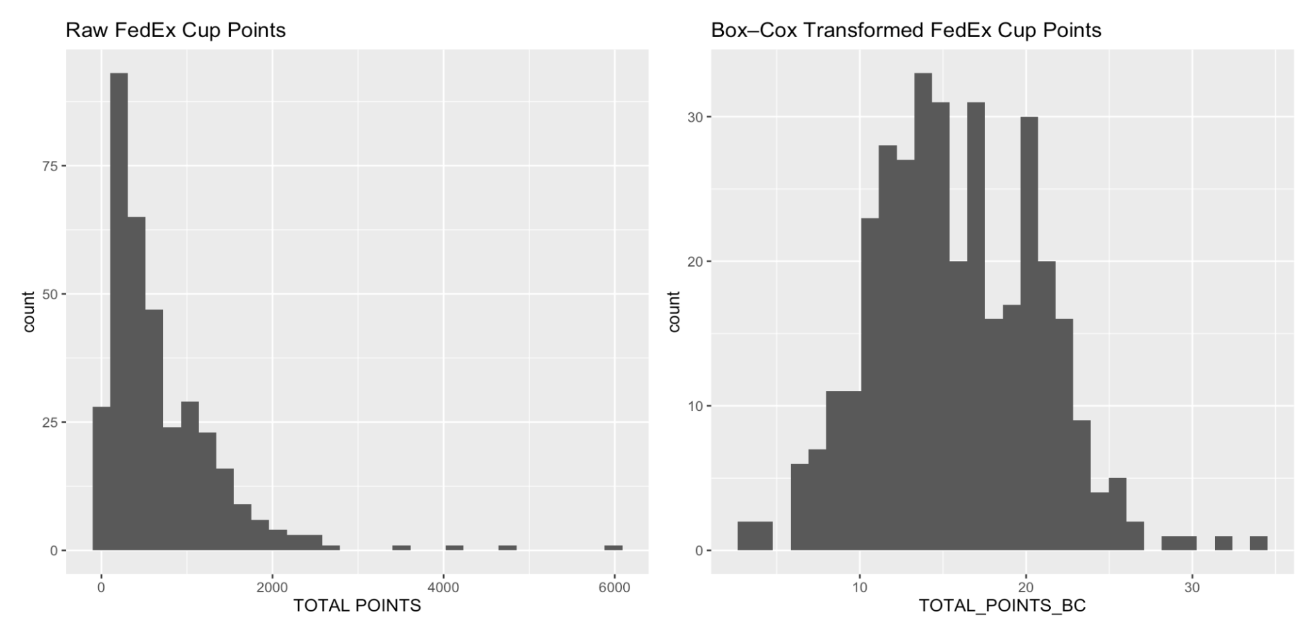
Normalizing Outcome Variable (FedEx Cup Points)
Why We Needed to Normalize FedEx Cup Points:
FedEx Cup Points were highly right-skewed, with many players earning 0 points, violating linear model assumptions:
Non-normal residuals
Heteroscedasticity
Bad fit without transformation
Two Approaches We Explored
Box–Cox Power Transformation (λ ≈ 0.26)
Shifted points by +1 to handle zeros
Estimated λ using 2024 data
New outcome variable distribution shown →
Gamma GLM with Log Link
Alternative approach using glm(..., family = Gamma(link = "log"))
Produced similar results, but had less accurate predictions than the Box-Cox method

Slide 8
Results: Explanatory Analysis (2024 Findings)
Rate Stats Model (FIR, GIR, Scrambling, Putting Avg)
Overall fit: R² = 0.488 → Explains ~49% of variation in FedEx Cup Points (transformed)
Significant predictors:
GIR% = Players who hit more greens score more FedEx points.
Overall Putting Average = More putts per hole strongly reduces scores.
Non-significant predictors: FIR% and Scrambling%
Interpretation: Rate stats identify only two meaningful variables and don’t capture much performance variation.
Strokes Gained Model (Tee, Approach, Around Green, Putting)
Overall fit: R² = 0.6039 → Explains ~60% of variation (much higher!!)
All four SG metrics are significant and have positive relationships with points.
Interpretation: Every SG variable has a significant relationship with performance and this model explains a lot more of the variation in scoring than the rate stats does.

Slide 9
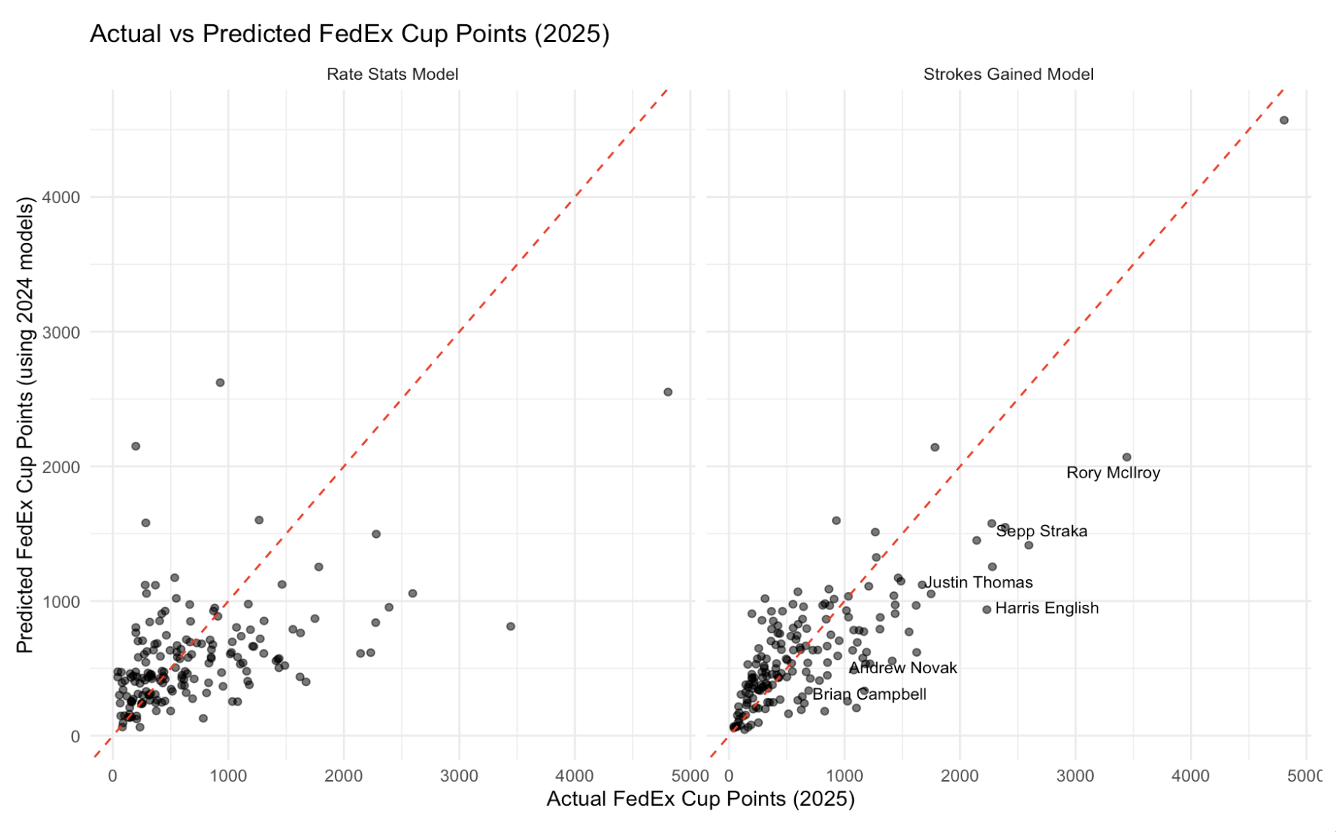
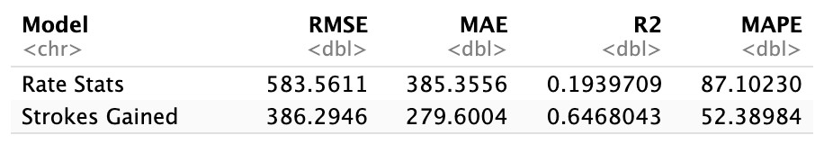
Results: Predictive Performance (Forecasting 2025)
Predictive Correlation (Primary Metric)
Rate Stats Model: r = 0.49
Strokes Gained Model: r = 0.81
→ SG model more than doubles
predictive accuracy.
Full Predictive Performance Metrics
Interpretation:
Notes:
SG reduces large errors by ~34%
SG misses by ~105 fewer points on average
SG explains 65% of 2025 variation
(rate stats explain almost none)
SG is much less biased for high-scoring players
3. Actual vs Predicted Scatterplots
Points cluster near 45° line in the SG model.
Notes:
*Gamma models had a higher rmse and lower R^2
SG RMSE = 513.9553
SG R^2 = 0.3747858
Rate RMSE = 641.1642
Rate R^2 0.02699162

Slide 10
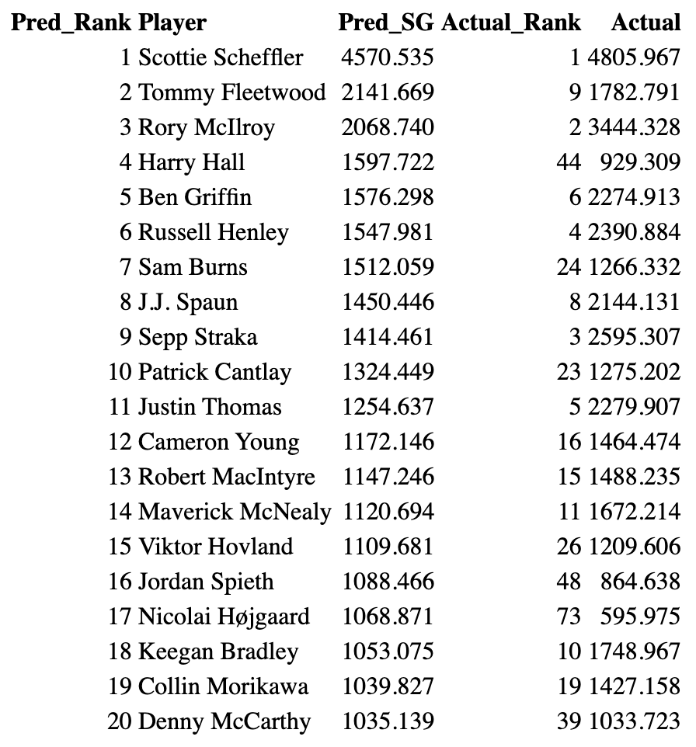
Predicted 2025 Ranking Accuracy (SG Model)
SG model correctly ranked top players
Scheffler #1, McIlroy in the top 3, Henley in the top 5
Most top 10 players were placed close to their true ranks
Misses (Harry Hall, Spieth) likely due to limited events and inconsistent season results.
Overall, SG predictive rankings align much more closely with actual 2025 standings.

Slide 11
Interpretation
Strokes Gained metrics clearly outperform traditional rate stats.
SG variables explained more variation in 2024 FedEx Cup points and produced much more accurate predictions for 2025.
SG Approach and SG Putting were the strongest individual skills that mattered.
Traditional rate stats missed key performance factors (weak relationships).
Predictive performance strengthened this conclusion.
SG predictions aligned closely with actual 2025 outcomes (r = 0.81), while rate stats performed poorly (r = 0.49).
Overall: Strokes Gained metrics are better predictors and better explanatory variables for understanding PGA Tour player performance across seasons.

Slide 12
Thanks!

Slide 13
Sources
Broadie, M. (2012). Assessing golfer performance on the PGA TOUR. Interfaces, 42(2), 146–165.
https://doi.org/10.1287/inte.1120.0626
Dealing with Right-Skewed Data. (n.d.). CRAN. Retrieved November 9, 2025, from
https://cran.r-project.org/web/packages/GlmSimulatoR/vignettes/dealing_with_right_skewed_data.html
PGA Tour Statistics. (n.d.). PGA Tour. Retrieved October 16, 2025, from https://www.pgatour.com/stats
Transformations. (n.d.). Cornell CSS. Retrieved November 12, 2025, from
https://www.css.cornell.edu/faculty/dgr2/_static/files/R_html/Transformations.html
Validating Strokes-Gained Method: Measuring PGA Tour Player Success. NYC Data Science. Retrieved October 29, 2025,
from https://nycdatascience.com/blog/r/validating-strokes-gained-method-measuring-pga-tour-player-success/

